Slide 1
No Nonsense Phonics Skills written by Debbie Hepplewhite
Training PowerPoint developed by Jamie Hallums,
Assistant Head, Kobi Nazrul Primary School
No Nonsense Phonics Skills programme
trialled in Kobi Nazrul Primary School

Slide 2
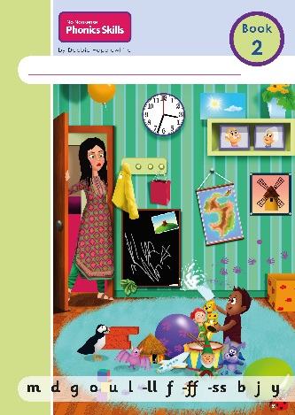
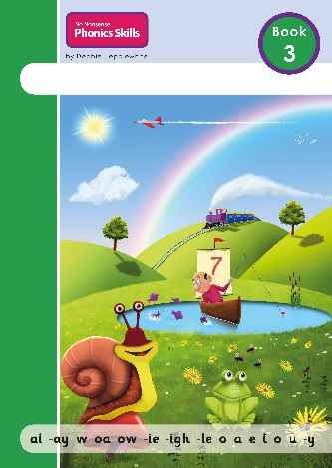
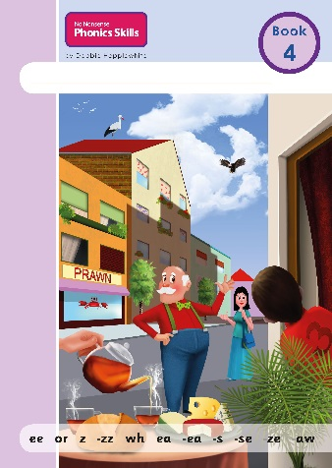
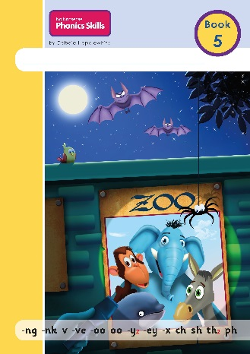
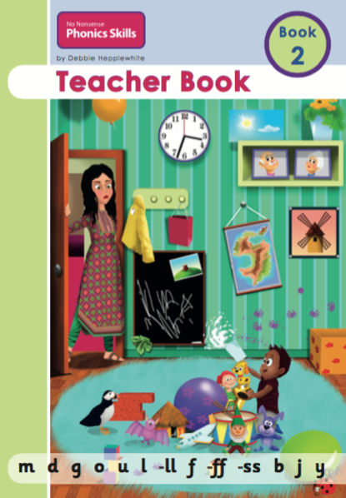
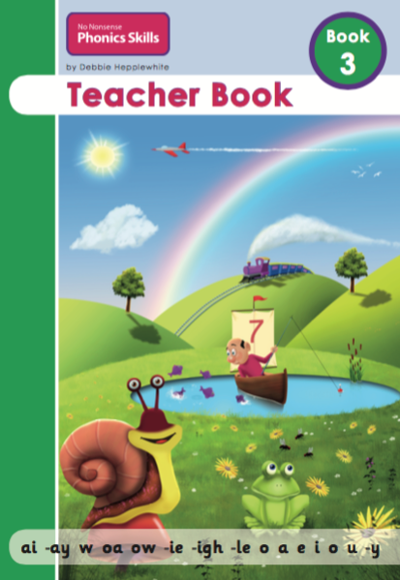
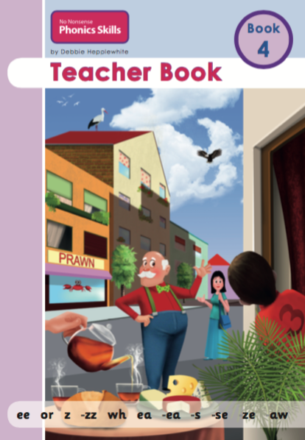
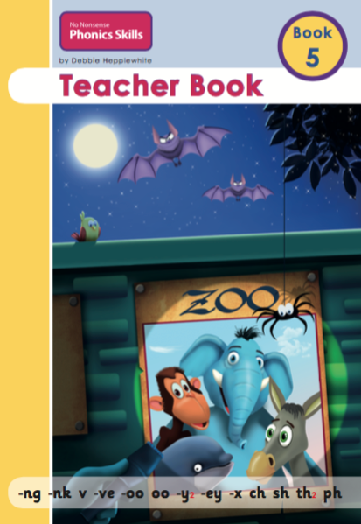
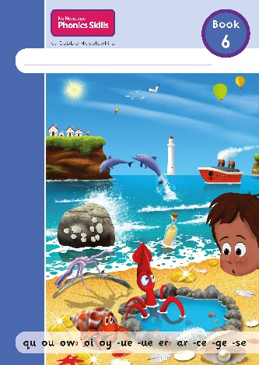
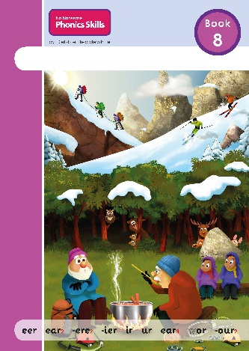
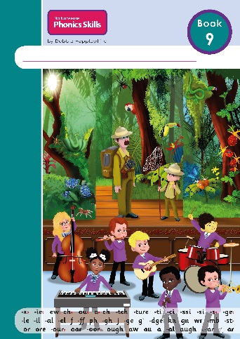
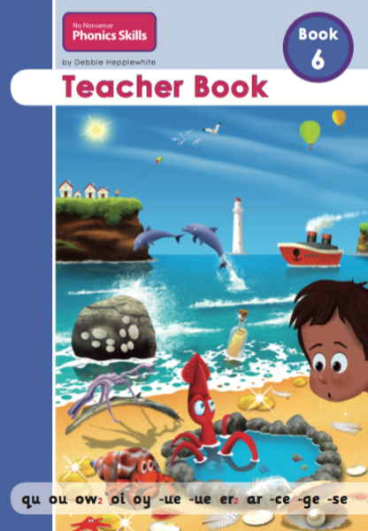
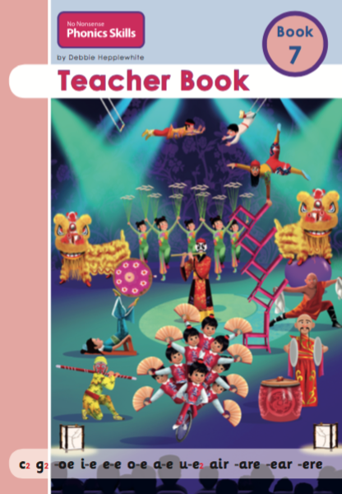
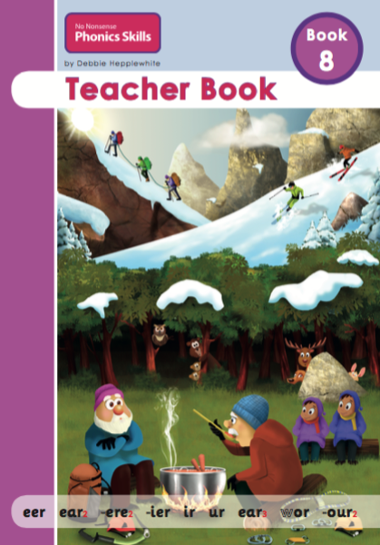
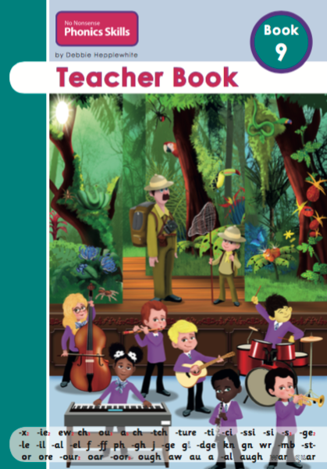
Systematic Synthetic Phonics: Nine Pupil Books and Nine Teacher Books
NNPS Starter Kit includes 9 Pupil Books X 6 (54 books), 9 Teacher Books, 6 tabletop Alphabetic Code Charts plus a USB Stick with additional resources and video footage
Notes:
Now I’ll take you through a quick look at the core resources and supplementary resources for the No Nonsense Phonics Skills programme and briefly describe their role.
The programme provides a comprehensive step-by-step method for teaching reading, handwriting and spelling. I guide [Debbie guides] the learner and the teacher through a series of carefully designed books that include all the phonics knowledge and routines necessary to master the complex English Alphabetic Code.
The Pupil Books include alphabetic code information and provide the terminology and ongoing guidance to support the teacher in instructing the pupils.
For every Pupil Book, there is a corresponding Teacher Book with information and guidance that is additional to the guidance for teachers provided within the Pupil Books.

Slide 3
No Nonsense Phonics Skills
A comprehensive step-by-step method for teaching reading, handwriting and spelling
Provides systematic and rigorous phonics teaching and practice with a rich vocabulary
Teaches handwriting linked to the English Alphabetic Code and the Alphabet
Applies and extends phonics to reading and writing text, developing language comprehension
There are nine levels provided in nine Pupil Books – each with a parallel Teacher Book.

Slide 4
No Nonsense Phonics Skills
The programme is based on the Five Pillars of Literacy model informed by research:
Phonemic awareness
Develop awareness of the smallest sounds in speech (PA)
Phonics knowledge
Teach the alphabetic code and phonics skills explicitly and systematically (includes PA)
Vocabulary
Teach new words explicitly to enrich vocabulary
Reading fluency
Provide ample repetition and repeat reading
Comprehension
Oral comprehension (spoken language) and reading comprehension of how to interpret literature

Slide 5
The Simple View of Reading
There are two main processes for being a ‘reader’ in the full sense:
Word decoding and word recognition: What ARE the words?
Language comprehension: What do the words MEAN?
Gough and Tumner’s SVoR model (1986)
Recommended by Sir Jim Rose (2006)

Slide 6
Links to Letters and Sounds
Broadly speaking, the NNPS programme links to Letters and Sounds (DfES 2007) in the following way:
Letters and Sounds | No Nonsense Phonics Skills
Phase Two | Books 1 and 2
Phase Three | Books 3 and 4
Phase Four No new correspondences introduced. | All NNPS books include words with consonant clusters. There are no books that are the equivalent of Phase Four as new correspondences are introduced continuously in NNPS.
Phase Five | Book 7, 8 and 9
Note: Some ‘Phase Five’ spelling and pronunciation alternatives are introduced both systematically and incidentally from Pupil Book 3 onwards.
See correlation chart for NNPS and Letters and Sounds via USB Stick resources.

Slide 7
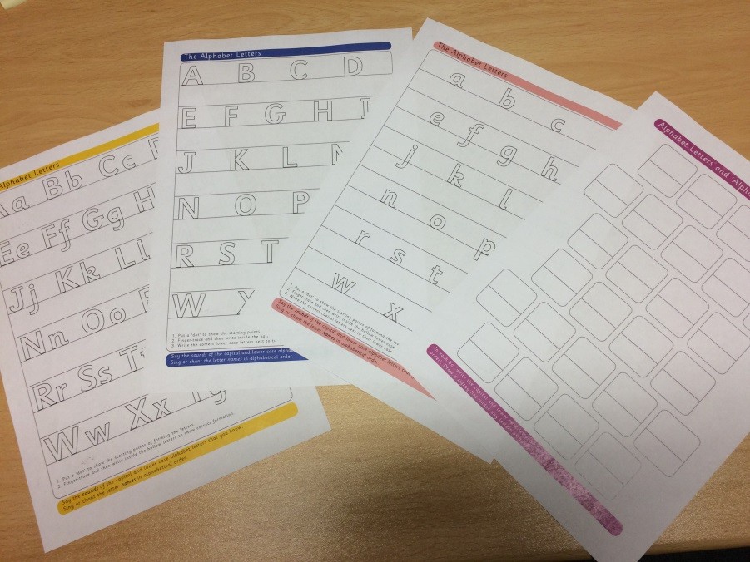
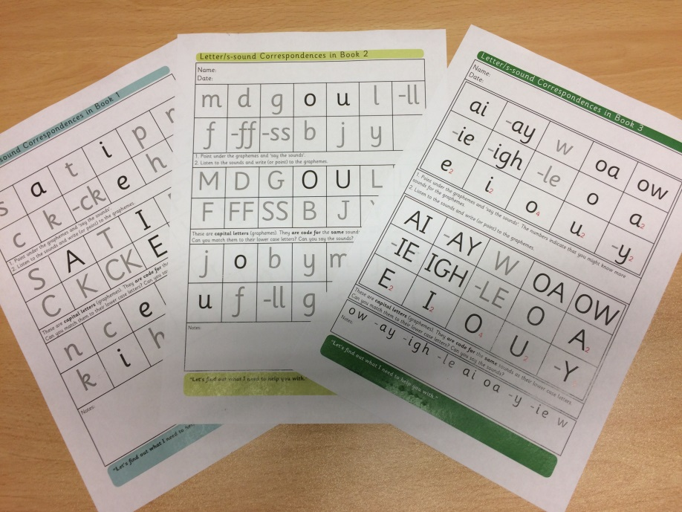
Entry Point Assessment (USB Stick)
The Alphabet Letters sheets (upper, lower case, ordering)
Letter/s-sound Correspondence sheets for Pupil Books 1 to 8
Use the assessment results alongside pupils’ ability to read, understand and accurately re-write the Mini Stories (as dictations) of the Pupil Books. Select the book level based on ‘best fit’. Start easier than pupils’ results and don’t skip any pages in the selected ‘best fit’ Pupil Book even if the ‘code’ is known on a page.

Slide 8
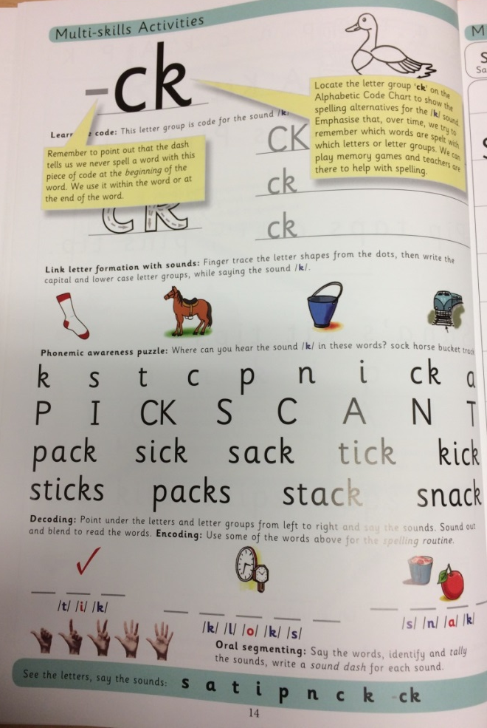
Teacher Books
The Teacher Books have yellow ‘post-it notes’ teaching points to support each session
with both specific and general guidance.
Read through all these points in each Teacher Book before using the parallel Pupil Book.

Slide 9
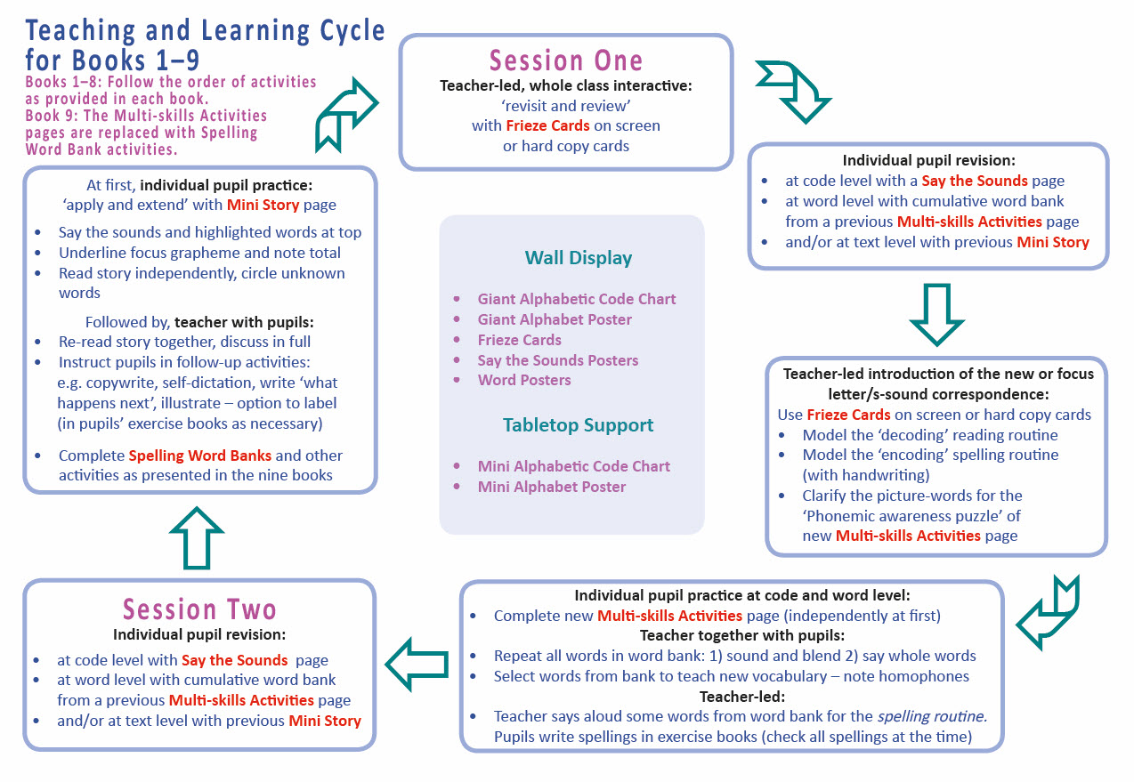
Teaching and Learning Pupil Books
Books 1-8: Follow the order of activities as provided in each Pupil Book.
The Teaching and Learning Cycle diagram is provided in the Teacher Books.
Book 9: The Multi-skills Activities pages are replaced with Spelling Word Bank activities.
Once started, in any one Pupil Book don’t skip pages just because a pupil might know the focus letter/s-sound correspondence already. There is far more content in the lesson than just the focus letter/s-sound correspondence.

Slide 10
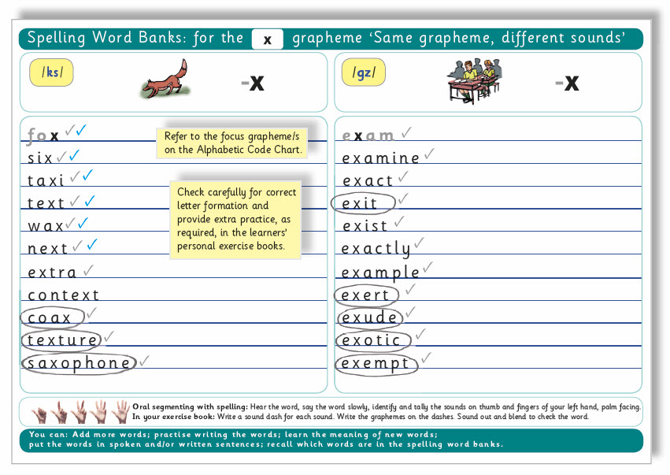
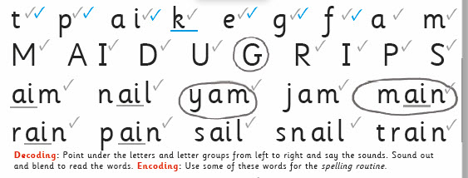
Marking and Monitoring
Pupils are engaged with their own sense of learning by marking what they think they ‘know’ and ‘don’t know well enough yet’ – this is routine practice.
Notes:
As I’ve mentioned already, the design of the programme includes the learners engaging with their own sense of learning and progress by being trained how to mark using a system of ticking and circling in pencil. Make sure the actual ‘ticks’ are very small and neat as this is a very good habit – not obscuring the print and not detracting from the purpose of the marking.
The teacher always ticks in pen whenever he or she witnesses firsthand the child saying sounds correctly or blending words correctly.
It does not matter if the child ticks inaccurately precisely because the adult is also marking the work. If there are times when you see a child’s tick but the child is not able to say the correct sound or word to you, then either don’t add your tick or develop a method where you, for example, underline the insecure correspondence or word. See the letter ‘k’ in the screenshot on the right. Perhaps you could say something like, “You’re not quite sure of that letter and sound yet, so I’ll just underline it to remind me to teach it again or you need some more practice to help you learn it”.
It is good practice to transfer this kind of information into the child’s own phonics exercise book. You might need to do this for flagging up letter/s-sound correspondences that are causing particular difficulty to learn to automaticity or any letter formation that isn’t secure even after teaching and some practice in the Pupil Books.
It’s not sufficient for teachers to consider that they have ‘high expectations’ of the children. We must have high expectations but coupled with ensuring that we model well enough in the first place and then we sort out any knowledge and skills that are weak in any way by establishing the highest standards of routines and behaviour. A lot of successful learning is simply about providing fit-for-purpose content and then training children in good routines and good habits and providing sufficient practice for the children.
With regard to the final ‘encoding’, or spelling, routine in the phonics exercise books, the children cannot ‘tick’ their own spelling attempt until the teacher actually sees the spelling to make sure it is correct. You don’t want invented, or plausible, spelling to become habitually embedded as this supported spelling activity is about totally accurate spelling. The words the teacher says aloud for the children to spell (remember spelling is a sound-to-print process) are selected from current work in the main and these are spelling exercises for teaching and learning – they are not ‘tests’ as such. You are not trying to catch the children out, you are teaching them and you need to know that they are growing their knowledge and spelling ability. This does not mean that you cannot give a spelling test periodically for your formal record-keeping, or give a teacher-led dictation for a staged formal assessment, but your ethos should be based on the notion that if children make mistakes either you have not yet taught them well enough, or they have not yet had enough practice, or they need a ‘reminder’ because something is particularly tricky or hard to remember.
Finally, you can of course annotate the children’s work both in their own Pupil Books and in their phonics exercise books with child-friendly language – and reward their efforts with comments, stars, stickers, smilies or whatever you generally prefer to use to encourage them. Please don’t neglect this encouraging and respectful aspect of your provision.

Slide 11
Phonics Exercise Book
Give each pupil a lined exercise book for additional activities to use alongside the Pupil Books.
How are they used?
Note in the exercise book where learners have difficulty with specific letter/s-sound correspondences, or letter formation. Then ensure extra personalised practice as required.
Use the exercise books for the ‘spelling routine’ (the last activity of the Multi-skills Activities pages).
Use them routinely for copy-writing of the Mini-Stories. In later books, or when individuals are ready, they can be used for more challenging ‘self-dictation’ where learners read, reread, and then write each sentence of a story held in memory, in their best handwriting.
Eventually, learners can write their own ideas for ‘what happens next’ in the Mini Stories, or write their own thoughts in response to the comprehension questions.
Quick sketches are drawn in the books to illustrate the Mini-Stories to deepen language comprehension.

Slide 12
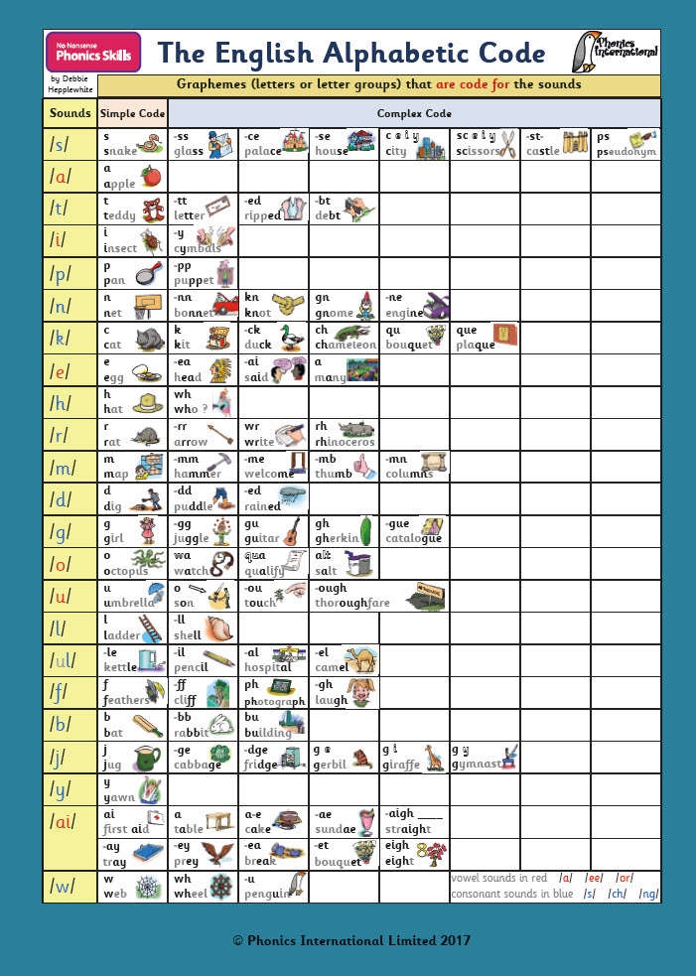
Display support for every session
WALL DISPLAY
(USB Stick printables)
Giant Alphabetic Code Chart
Giant Alphabet Poster
Frieze Cards
Say the Sounds Posters
Word Posters
TABLETOP SUPPORT
Mini Alphabetic Code Chart
Mini Alphabet Poster (USB Stick printable)

Slide 13
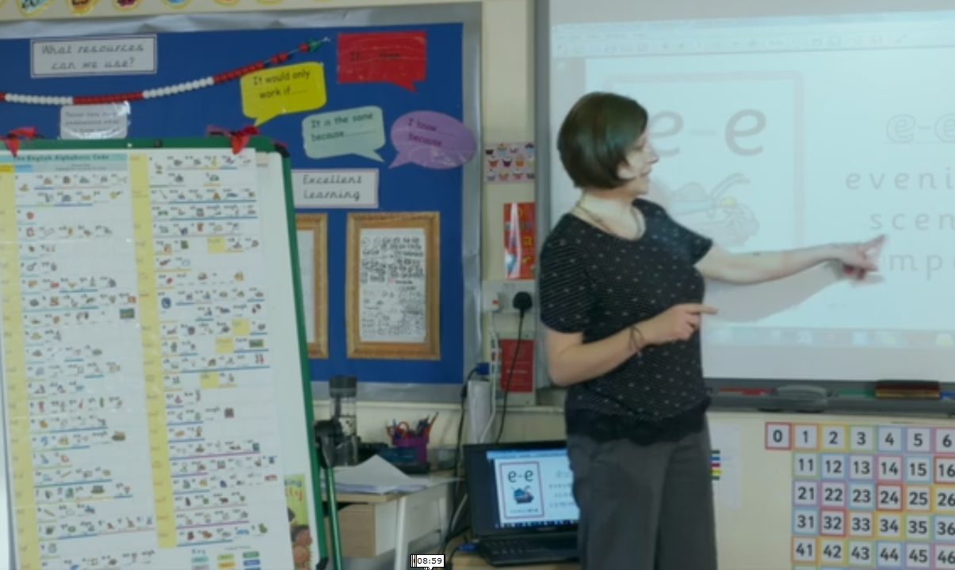
Giant Alphabetic Code Chart
A visual chart helps to show the Code and exemplify spelling alternatives.
At the beginning of planned lessons point to the focus sound and grapheme and refer to any spelling alternatives that you have already introduced or that you will teach later.
Use it in class when you discover further letter/s-sound correspondences in rare or unusually spelt words in the wider curriculum, which you can add to the chart.
Print this resource, laminate and stick together in the order that each page is presented and display as two columns in a very prominent, low, position.

Slide 14
Giant Alphabet Poster
Print and display this poster prominently and accessibly. Consider printing extra copies to display in any breakout teaching areas and to create browse books where required.

Slide 15
Frieze Cards
Frieze Cards are used to introduce the new or focus letter/s-sound correspondence.
Optional use:
Use them to create a frieze display in the classroom or teaching area or for quick-fire ‘revisit and review’ with groups or whole classes.
Fold them in half and laminate to make double-sided flash cards.
Put them in plastic sleeves in folders to create browse books.
Project on main whiteboard to introduce focus correspondence and to model phonics skills with words provided.
Words in small font in the bottom left of each Frieze Card provide you with words to say as spoken words to model the encoding (spelling) process.

Slide 16
Say the Sound Posters
Print A4 versions for small-scale posters or as tabletop visual aids – and enlarge to A3 for large-scale posters displayed around the classrooms or teaching areas – even in cloakrooms or places where children routinely line up, play or spend a lot of time.
Send printed copies home in the book bag to inform parents or carers and to enable extra practice at home.
Both learners and supporting adults can tick paper versions and circle any code not known confidently.
Use the posters as liberally as possible to encourage ‘little and often’ practice.

Slide 17
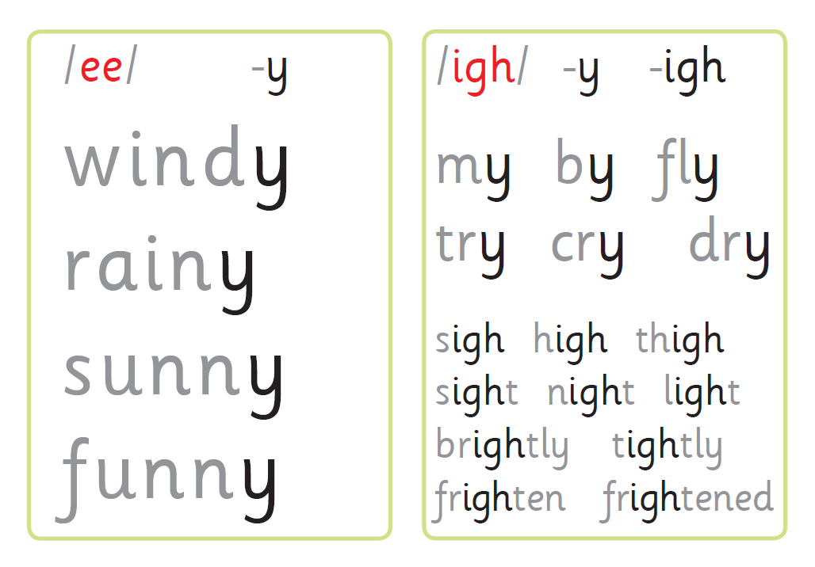
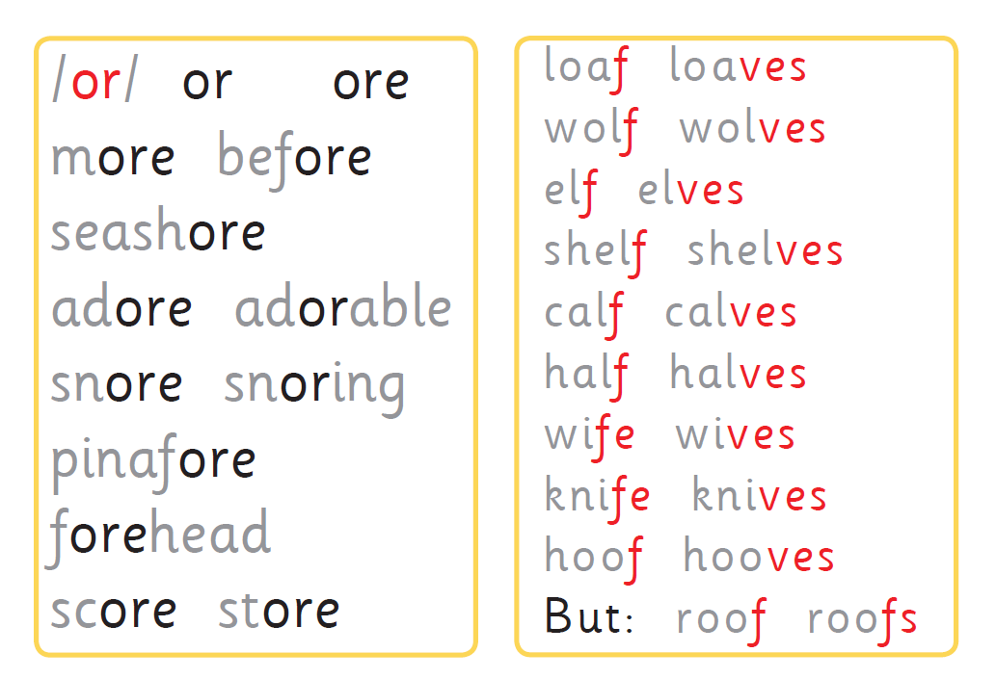
Word Posters
Word Posters provide examples of word groupings or tricky words presented in different ways.

Slide 18
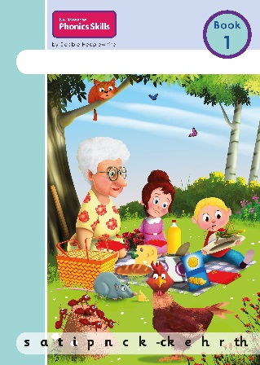
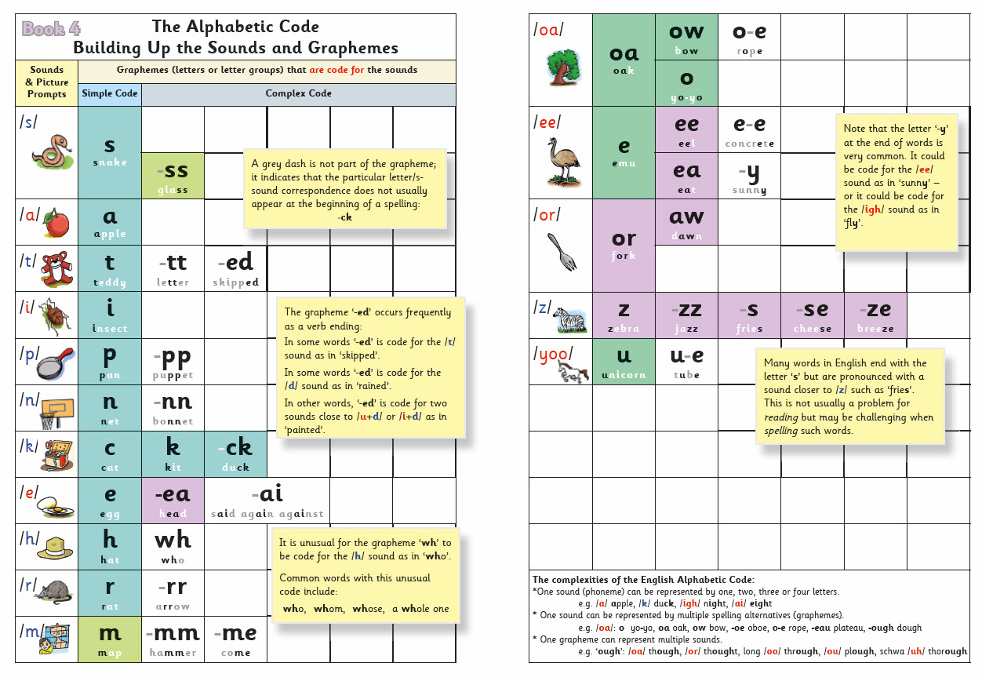
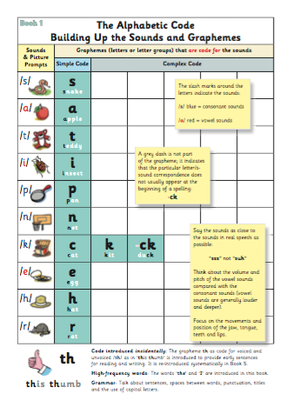
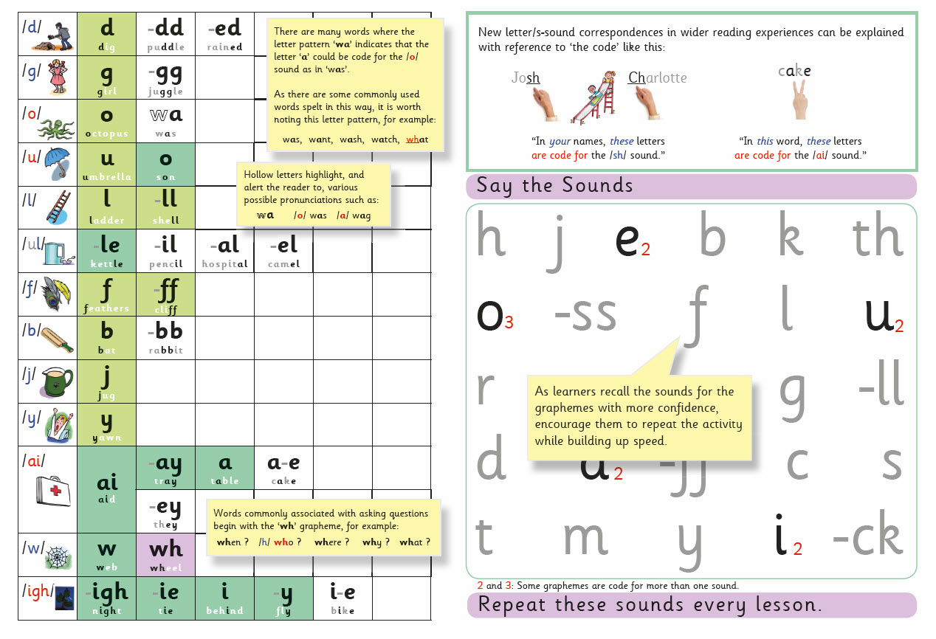
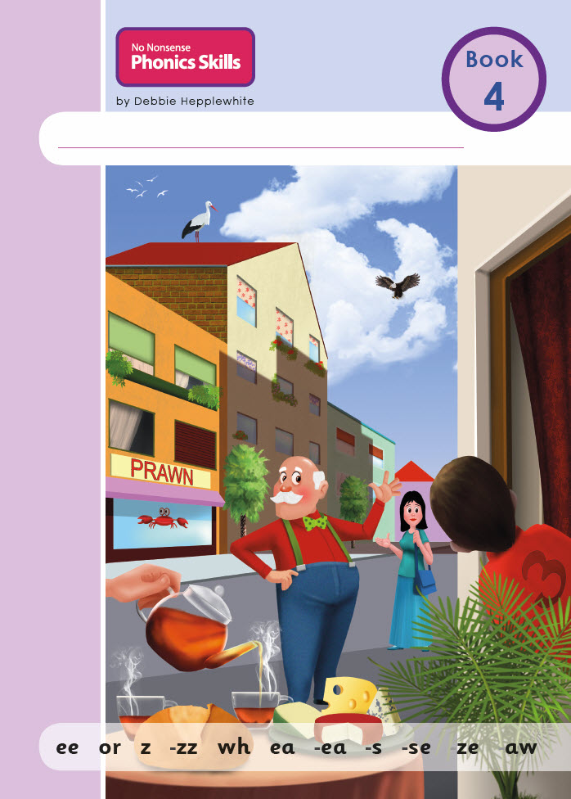
Cumulative Alphabetic Code
Chart found in the inside cover of each Pupil Book includes the letters/s-sound correspondences covered in the current and previous books – plus some additional correspondences added in steps.
Tabletop Alphabet
Print and laminate copies to support pupils who are still unsure of the letter formation of any letter shapes, the matching of capital letter and lower case letter shapes, and who are unsure of the alphabetical order.

Slide 19
Session One
1. Teacher-led, whole class interactive: (6:24 to 6:56 of film) | ‘revisit and review’ with Frieze Cards on screen or hard copy
2. Individual pupil revision: (6:56 to 8:32 of film) | Say the Sounds page (Book 3 onwards) Work bank from previous Multi-skills Activities page and/or Previous Mini Story
3. Teacher led introduction of the new or focus letter/s-sound correspondence: (8:32 to 11:33 of film) | Frieze card on screen or hard copy Model the ‘decoding’ reading routine Model the ‘encoding’ spelling routine (with handwriting) Clarify the picture-words for the ‘phonemic awareness puzzle’ of the new Multi-skills Activities page
4. Individual pupil practice at code and word level: (11:33 to 12:14 of film) | Independently at first - complete new Multi-skills Activities page Teacher together with pupils – repeat all words in word bank: 1) sound and blend, 2) say whole words. Teacher together with pupils – select words from bank to teach new vocabulary and note homophones Teacher led – teacher says aloud some words from word bank for the spelling routine. Pupils write spellings in exercise books (check all spellings at the time and also check for correct letter formation).

Slide 20
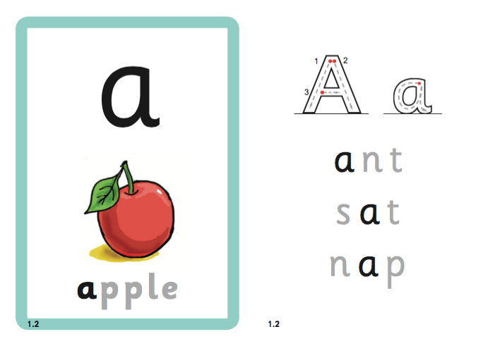
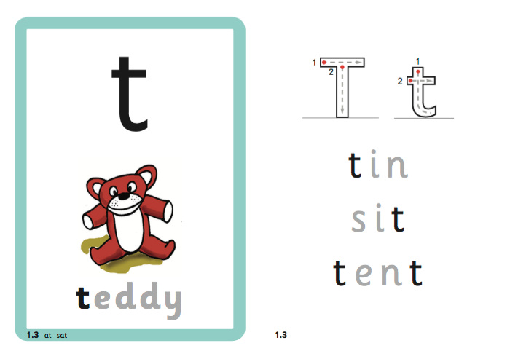
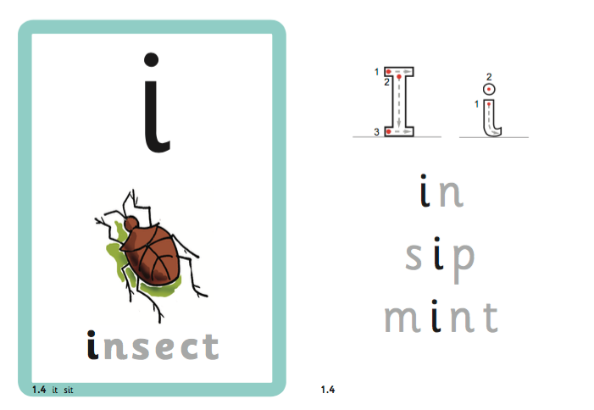
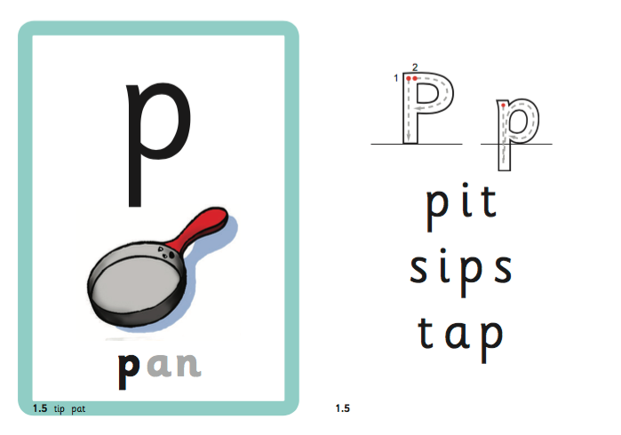
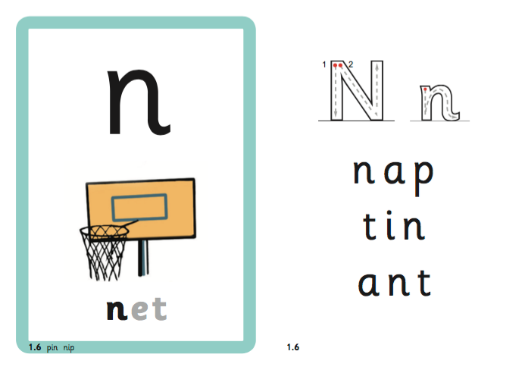
1. Revisit and Review: Frieze Cards
As each letter/s-sound is covered, build up the Frieze Cards used in the revisit and review part of the lesson.

Slide 21
2. Revisit and Review: Say the Sounds
Children tick the sounds they think they know and circle those they don’t know or are unsure about – from print to sound is a sub-skill of reading.
Children tick in pencil, adults tick in pen any sounds they’ve heard that are correct. This is ongoing informal monitoring.
Write any letters or letter groups that children are unsure of in their personal exercise book.
Also – adult can generate the sounds (“/k/ as in kit, /k/ as in duck”) and pupils point to correct grapheme on their sheet - from sound to print is a sub-skill of spelling.

Slide 22
2. Revisit and Review: Word Bank from Multi-skills Activities page
Children independently work through the code and words from the previous lesson.
Encourage them to sound out if unsure, or say the whole word if they recognise it.
Prompt children to explain the meanings of new words.
Cumulative word bank

Slide 23
2. Revisit and Review: Previous Mini Story
Children independently read through the Mini Story covered in the previous session to build confidence and fluency.

Slide 24
3. and 4. Introduce new letter/s-sound correspondence and Multi-skills Activities
Follow the same routine each session:
Refer to the focus sound and grapheme on the Giant Alphabetic Code Chart.
After children have completed the page independently, collectively with the children repeat the code and say all the words in the word bank:
1) sound out and blend the words 2) say whole words together at a slow pace 3) ask the children to say the words in simple sentences 4) select words from bank to teach new vocabulary and note any homophones (words that sound the same with more than one meaning)

Slide 25
Guidance for Phonics Routines
Learn the code:
Use the terminology, the letter or letter group “is code for” the sound, in preference to saying that letters “make sounds”.
Link letter formation/handwriting with sounds:
Explain that capital letters are code for the same sounds as their lower case equivalent letters. They are used for special reasons like first letters of names and beginning sentences.
Constantly reinforce tripod pencil grip, saying “Let me help you…”
Encourage slow, very careful handwriting.
Note any incorrect letter formation (model if necessary).

Slide 26
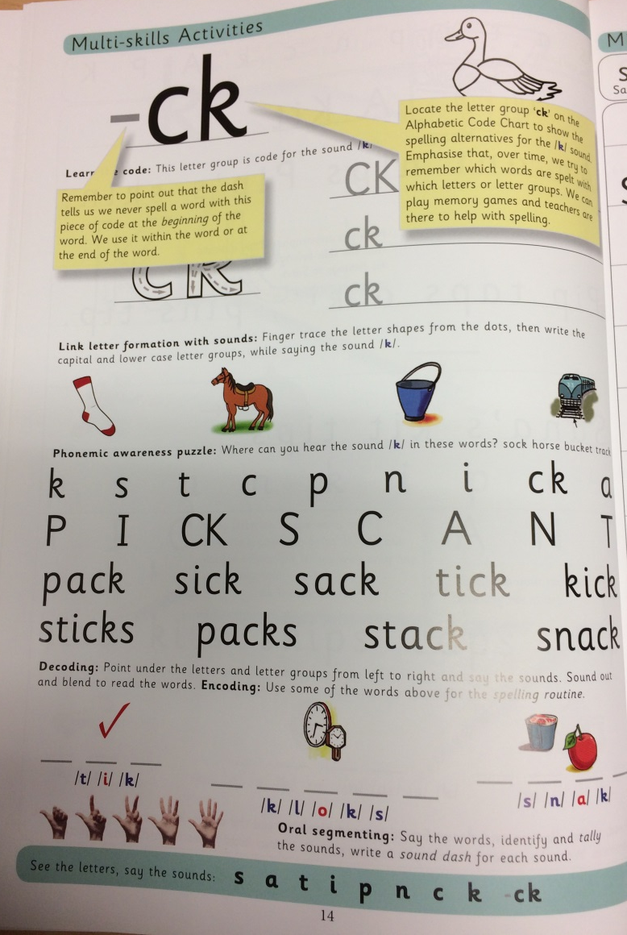
Guidance for Phonics Routines
Phonemic awareness puzzle:
Model how to say each picture-word very slowly and naturally to identify the focus sound at the beginning, within, or at the end of the word.
The ‘odd one out’ is the picture-word that does not include the focus sound.
Show learners how to put a cross next to it.

Slide 27
Guidance for Phonics Routines
Decoding:
Model how to point under each grapheme as you say each sound then run your finger under the word, from left to right, as you say the word.
Marking:
Engage pupils with a sense of their own learning. They sound out and tick (in pencil) the graphemes they think they know.
They also tick after sounding out and blending the whole printed words.
They circle any decoded words where the meaning is not known.
Teacher ticks (in pen) the graphemes and printed words they hear sounded out correctly.
Do not mark incorrect responses with a cross – simply leave them blank.

Slide 28
Guidance for Phonics Routines
Oral segmenting:
Say each picture word very slowly and naturally to identify all the sounds from beginning to end of the word.
Then say each sound separately and tally the sounds on thumb and fingers of the left hand, palm facing.
Count the sounds.
In Book 1, draw the correct number of ‘sound dashes’.
Note: In Book 1, don’t continue to spell the picture-words with letters or letter groups – finish with the ‘sound dashes’ only.

Slide 29
Guidance for Phonics Routines
Encoding (the spelling routine):
Complete this skills activity last in the exercise books.
Model how to orally segment the whole spoken word.
Write a sound dash for every sound identified.
Use the sound dashes as writing lines to write the correct graphemes correctly formed and positioned on the dashes.
Sound out and blend to check the word. Immediately check and tick, or correct if required.
Re-write the whole word on a line below whilst saying or thinking the sounds: /s/ /n/ /a/ /k/
(9:41 to 11:10 of film)
Children copy the oral segmenting with their own hands and air write along with the teacher at first.

Slide 30
Session Two
1. Individual pupil revision: (6:56 to 8:32 of film) | Say the Sounds page (Book 3 onwards) Work bank from previous Multi-skills Activities page and/or Previous Mini Story
2. Individual pupil practice: (12:14 to 13:52 of film) | ‘apply and extend’ with new Mini Story page Say the sounds and the highlighted words at top Underline focus grapheme and note total Read story independently, circle unknown words
3. Teacher with pupils: (13.52 to 14:22 of film) | Re-read story together, discuss in full and use suggested comprehension questions (in parallel Teacher Book) Instruct pupils in follow-up activities, e.g. copy write, self-dictation (as soon as able), write ‘what happens next’, illustrate (in pupil exercise books as necessary)

Slide 31
1. Revisit and Review: Say the Sounds
Children tick the sounds they think they know and circle those they don’t know or are unsure about - from print to sound is a sub-skill of reading.
Also – adult generates the sounds (“/k/ as in kit, /k/ as in duck”) and pupils point to correct grapheme on sheet - from sound to print is a sub-skill of spelling.
Note options:
Sometimes use laminated or paper ‘Say the Sounds Posters’, or use versions provided in Pupil Books from no. 3 onwards.
Use paper-based ‘Say the Sounds Posters’ for occasional assessment for formal record-keeping per pupil.

Slide 32
1. Revisit and Review: Word Bank from Multi-skills Activities
Children independently work through the words from the previous lesson.
Encourage them to sound out if unsure, or say the whole word if they recognise it.
Prompt children to explain the meanings.
Cumulative word bank

Slide 33
1. Revisit and Review: Previous Mini Story
Children read through independently.

Slide 34
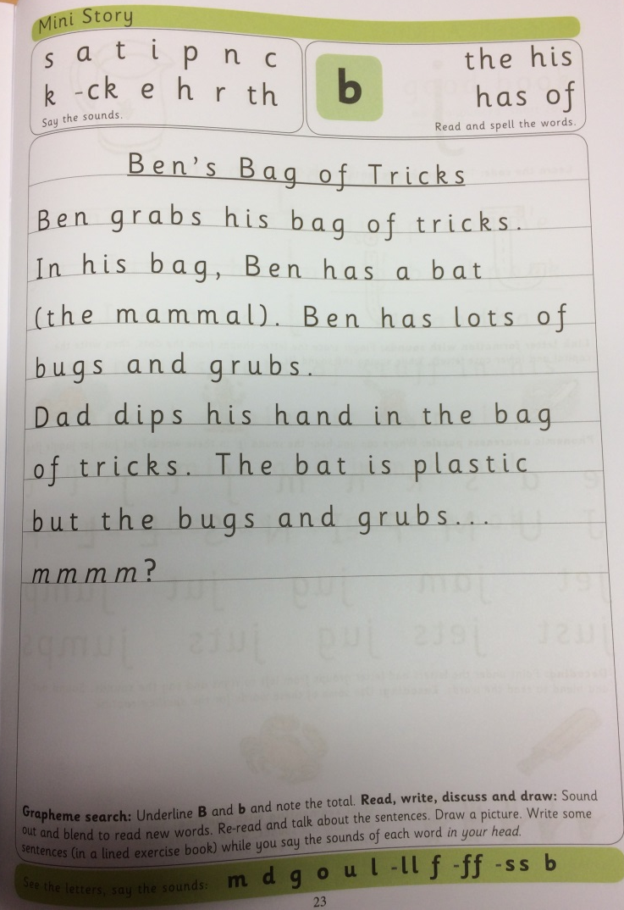
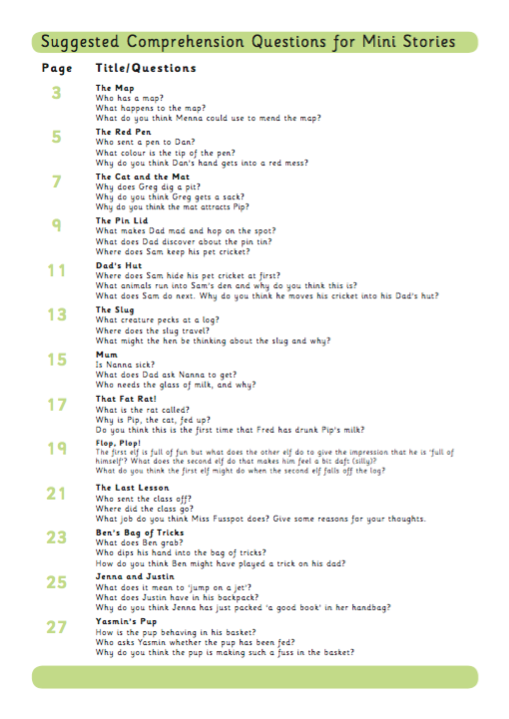
2. and 3. New Mini Story
‘Apply and extend’ with a new Mini Story page.
Say the sounds and the highlighted words at top.
Underline focus grapheme and note the total.
Read story independently, circle unknown words.
Re-read story together, discuss in full and use suggested comprehension questions.
Instruct pupils in follow-up activities, e.g. copy write, self-dictation, write ‘what happens next’, illustrate (in pupil exercise books as necessary).
Occasionally, conduct an adult-led ‘dictation’ for formal record-keeping.
The Teacher Book has a list of comprehension questions for each Mini Story.

Slide 35
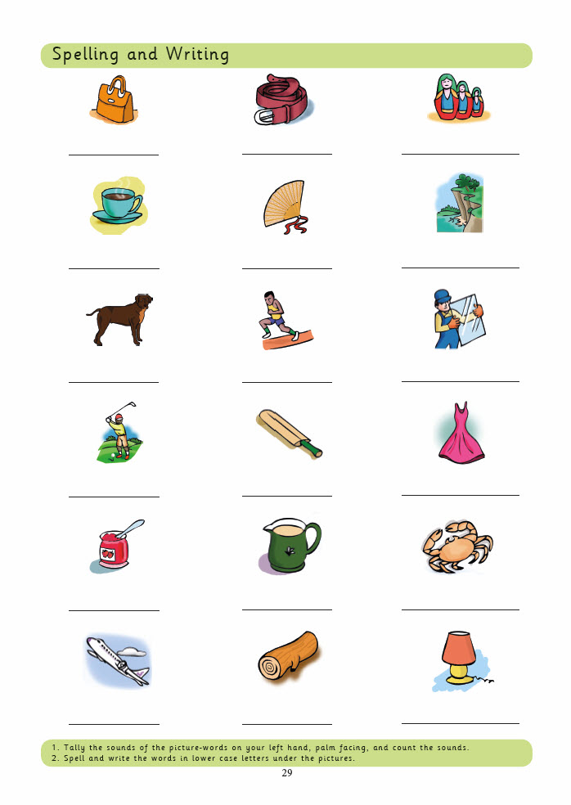
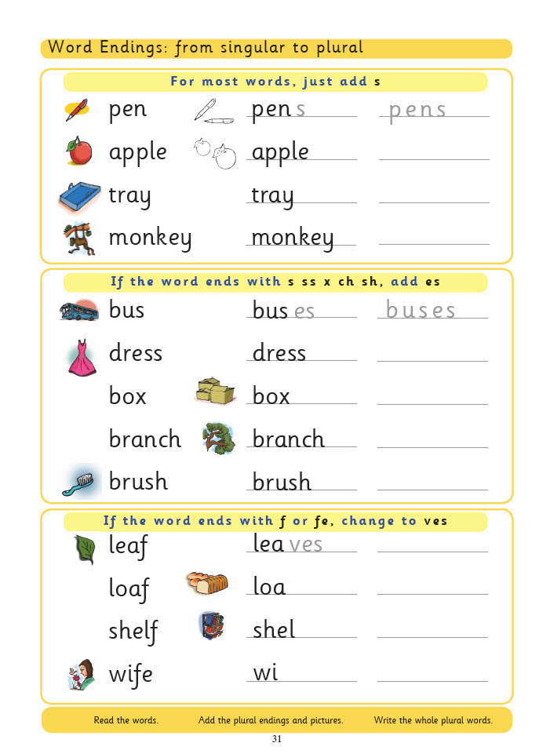
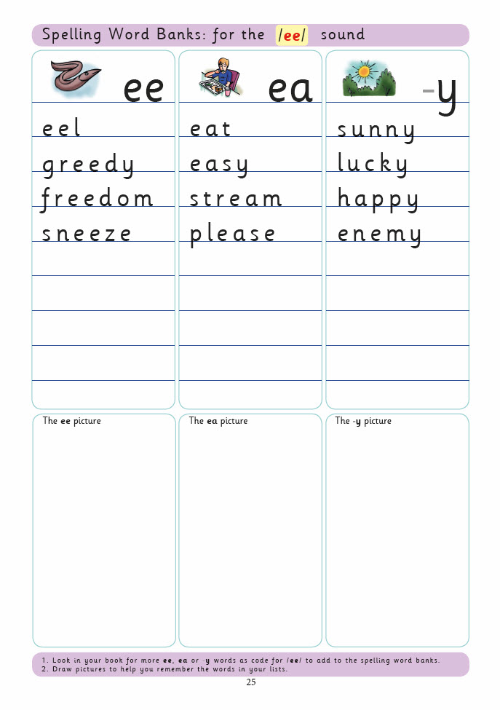
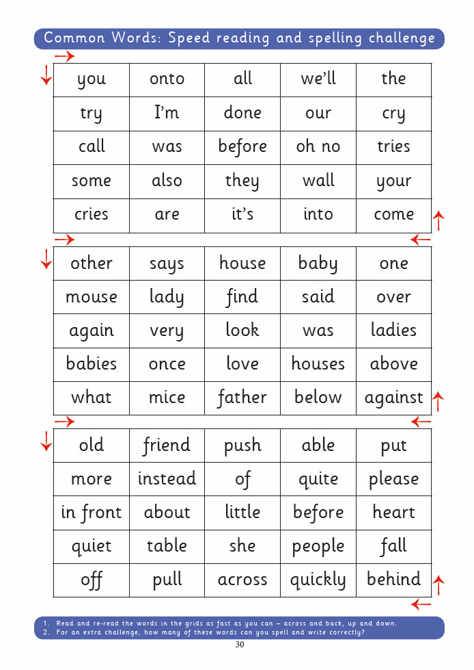
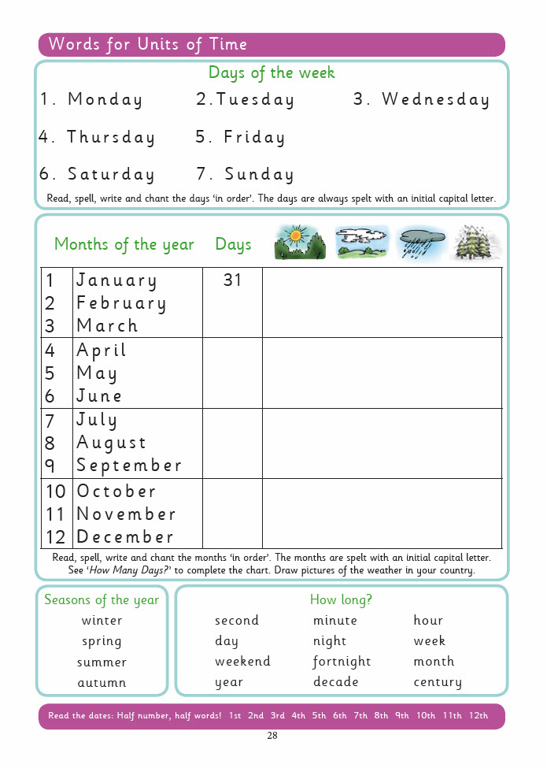
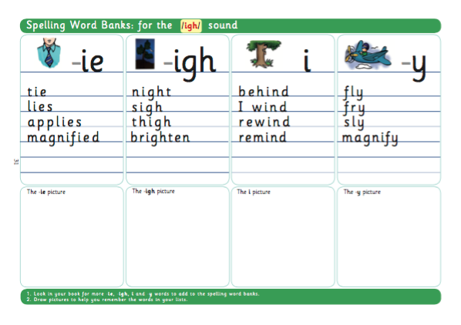
‘Spelling Word Banks’ and various additional activities
Help children to focus on which words are spelt which way.
“Can you tell me 6 words spelt with the focus letter/s-sound?”
Complete Spelling Word Banks and other activities as presented at the end of each Pupil Book.
Notes:
At the end of Pupil Books 1 to 8 (except Book 5 which features plural endings instead), there are activities based on building up knowledge of Spelling Word Banks of some of the code introduced in each book.
In Book 9, Spelling Word Banks with various suggested activities replace the Multi-skills Activities pages throughout the book. Of course any word work, including spelling words, should also include meaning-making and examples of using the provided words in spoken sentences and sometimes in written sentences. For older children, you can introduce the use of dictionaries to support the word and text level work.
These word banks mainly provide the ‘beginnings’ of Spelling Word Banks but they raise awareness of the need to do one’s utmost to remember which words are spelt which way for lifelong spelling knowledge. This, of course, is a long-term aspiration but we can sow the seeds for this from an early stage.
For older learners using the later books, you can extend the word banks found in the Pupil Books by listing further words in the pupils’ phonics exercise books according to your professional judgement. This is an ongoing need for spelling purposes along with taking an interest in the meaning of words, the structure of words, and their historical origins or country of origin.
In some of the Pupil Books, you will find additional activities for spelling, speed reading and spelling, word structure, prefixes and suffixes, singular and plurals. The programme is not a formal grammar programme, however, and you may want to complement this body of work with additional grammar activities. You can use the Mini Stories to teach or note aspects of grammar if and when you find the texts useful for such extension work.

Slide 36
Remember…
The sessions are full of routines and repetition – there should be no down times.
As the children begin to recognise the resources, the sessions become faster.
Quicker learners can be more independent, allowing the adult to focus on those who need closer supervision
Teaching needs to become time-efficient but allow sufficient time for learners to learn!
Contact debbie@phonicsinternational.com for support or with feedback.

