Slide 1
researchED & Oxford Univerity Press English and MFL Conference April 1st 2017 – Oxford, England

Slide 2
By Debbie Hepplewhite
What’s ‘holding back’ research-informed foundational literacy from reaching all teachers and learners?

Slide 3
Could it be … myths, misinformation, no national analysis of training or teaching, contradictory, weak or flawed guidance, different ideologies and beliefs, no universal training, weak phonics teaching and support, persistent phonics detractors?

Slide 4
We need a thorough national analysis
Arguably, we have no current informative national analysis nor clarity as to how best to move forwards – other than ‘surveys’.
Surveys simply reflect some people’s opinions and beliefs.
Many may think that in England ‘systematic synthetic phonics’ is officially promoted and adopted and therefore this is ‘job done’ – but this is far from the case as can be shown by plenty of evidence on the ground and via the media and internet, and according to the Y1 Phonics Screening Check and other literacy results.

Slide 5
We need a transparent review to join the dots
In the UK and internationally, teachers and others are not provided with the same messages as to what research-informed and leading-edge reading and spelling instruction ‘look like’.
Various people, and organisations, are giving out-dated and flawed information and training about reading instruction and intervention.
We’re failing to train well enough the whole teaching profession which should include education’s inspectorate.

Slide 6
We need rigorous national training in research and practice-informed foundational literacy for…
All teachers and teaching assistants
All headteachers and senior managers
All literacy and special needs advisors and trainers
All governors with a responsibility for literacy and special needs
All inspectors in education
All personnel involved with literacy organisations and charities, educational research organisations and publishing
Which of these people do you think don’t need to know about the findings of the body of research and leading-edge practice?

Slide 7
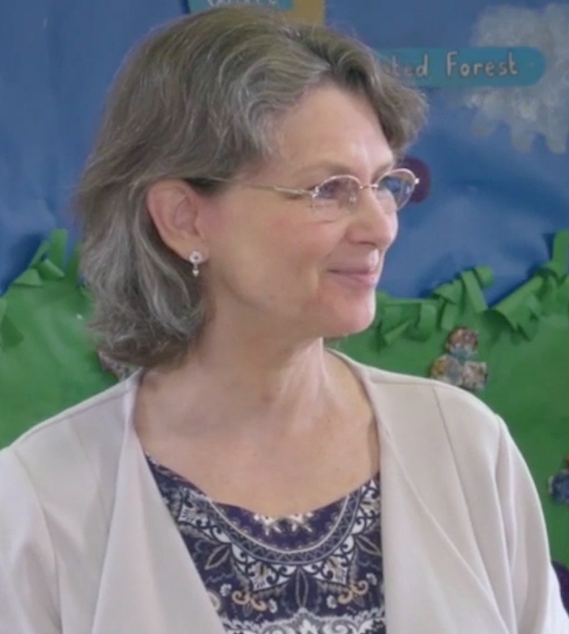
Debbie Hepplewhite MBE FRSA
Previously: primary teacher, headteacher, special needs teacher – currently: teacher-trainer & consultant
Author of the online Phonics International programme for all ages and contexts (2007)
Phonics consultant for the Oxford Reading Tree Floppy’s Phonics Sounds and Letters programme (2010)
Awarded an MBE for ‘Services to Education’ in the Queen’s New Years Honours List (2012)
Author of Phonics Training Online for foundational literacy and Debbie’s ‘two-pronged systematic and incidental phonics teaching and learning’ approach (2015)
Author of Phonics and Talk Time for Pre-schoolers (2017)
Member of DDOLL network
also RRF & IFERI committees
Notes:
As you can see, I have [Debbie has] plenty of experience of teaching, training and designing resources for the approach generally referred to as ‘Systematic Synthetic Phonics’.
I’m author of the Phonics International programme provided online - suitable for a range of ages and contexts – and published in 2007 by Phonics International Limited.
I was then invited to be the phonics consultant for the Oxford Reading Tree Floppy’s Phonics Sounds and Letters programme published in 2010 by Oxford University Press.
I’m also the author of ‘Phonics Training Online’ – a very comprehensive professional development programme for foundational literacy based on my ‘two-pronged systematic and incidental phonics teaching and learning’ approach. This was launched in 2015 and has students registered from around the world. I highly recommend this online training course.

Slide 8
researchED English and MFL Conference April 1st 2017 – Oxford, England
Tom Bennett, founder of researchED, aims for:
‘a grass-roots, teacher-led project that aims to make teachers research-literate and pseudo-science proof’
Helene Galdin-O’Shea, conference manager, promotes:
‘cross-institution pedagogic collaboration as part of professional development, in supporting teachers who, tired of top-down and often poorly-informed initiatives in schools, have rightly decided to reclaim their professionalism and take control of their own development, and in promoting and developing ways for educational professionals to share the best evidence available’

Slide 9
Embodiment of researchED aspirations…
1989
The UK Reading Reform Foundation was founded by a secondary teacher. Mona McNee challenged the prevailing ‘look and say’ method and taught her Downs Syndrome son to read with phonics. She made international contacts and promoted the need for standardised reading tests and scientific evidence to inform reading instruction.

Slide 10
Partly as a result of RRF campaigning, the UK Government has endorsed systematic synthetic phonics for the initial teaching of reading (and spelling) in primary schools in England. This is a huge achievement informed by both research and classroom findings (researchers and teachers collaborating) and embodied in the current National Curriculum for English Key Stages 1 & 2 (2014).
To this day, contradictory and less effective methods are being promoted by some academics, some education authorities, teachers’ union leaders, some literacy and intervention organisations - whether for mainstream teaching or for teaching children who have fallen behind their peers.
What is the evidence for this claim? How can we move forwards in England and wherever English is taught as a first or additional language?
See my blog at www.phonicsintervention.org for evidence that contradictory materials & guidance abound in 2017

Slide 11
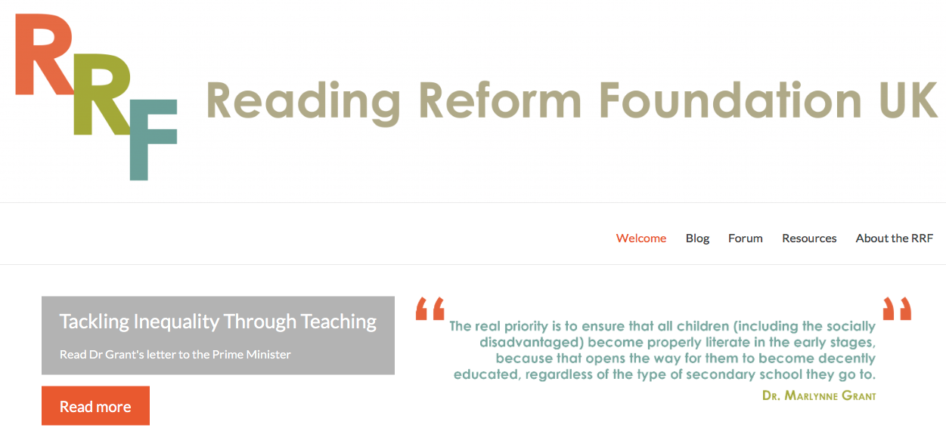
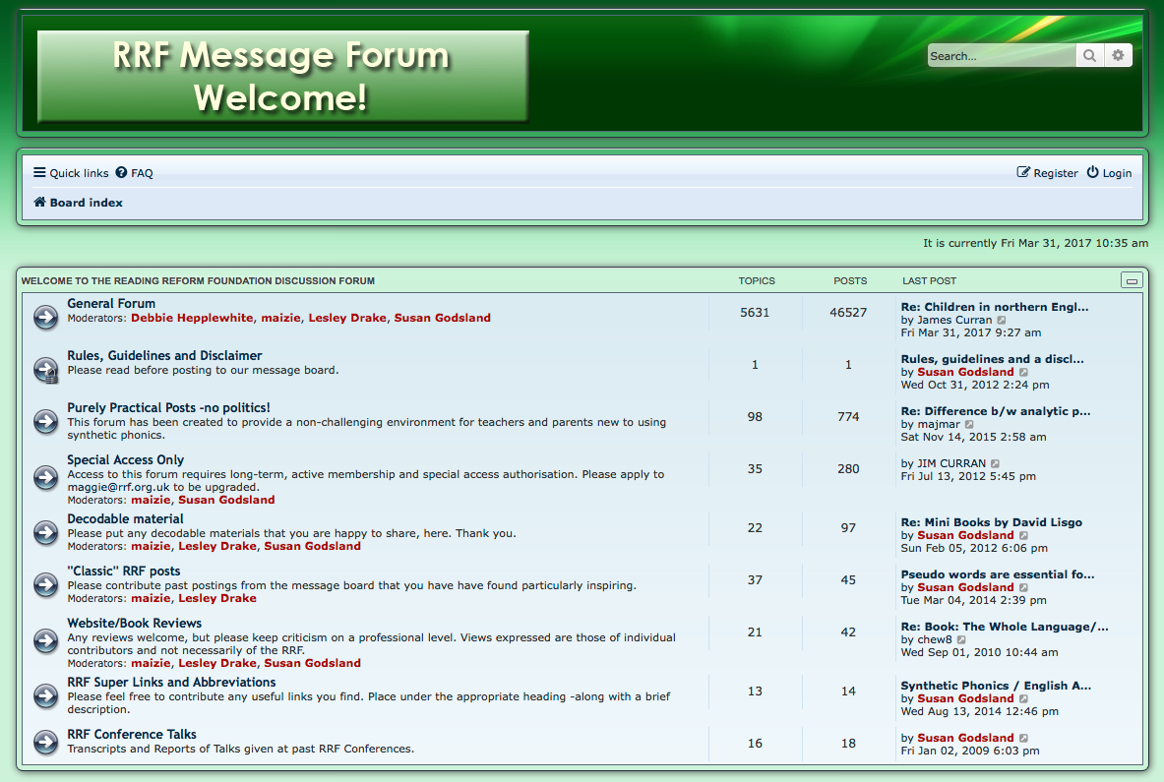
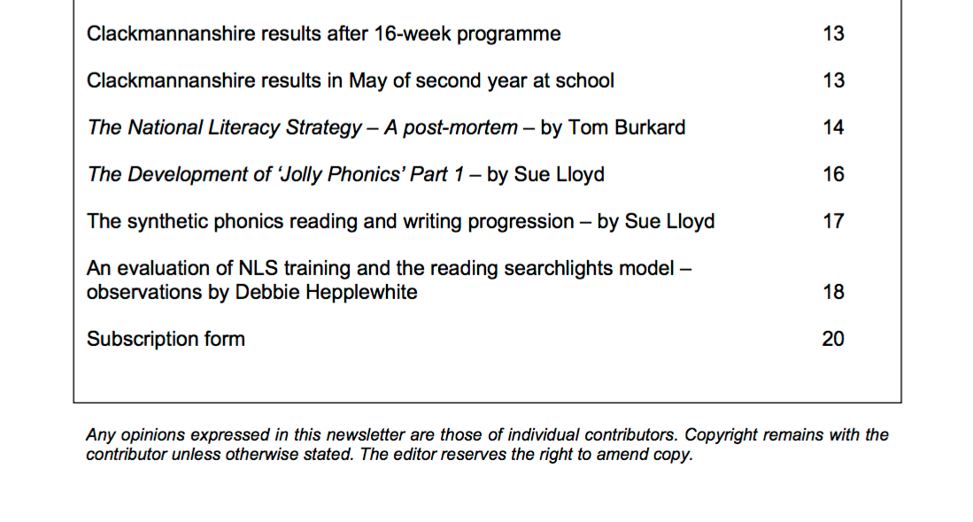
2001
New editor:
Debbie Hepplewhite
The UK Reading Reform Foundation provides a historic record of developments and links to evidence – both research and classroom findings.
Teachers and researchers challenged the official guidance in the National Literacy Strategy (1998).

Slide 12
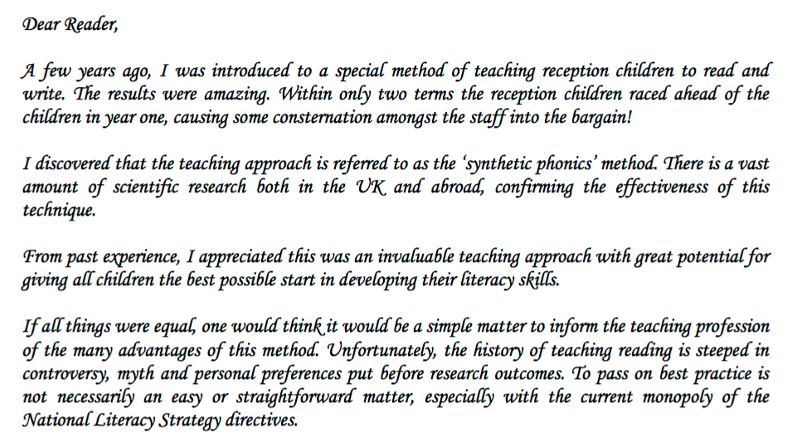
I wrote this in 2001 ‘…the history of teaching reading is steeped in controversy, myth and personal preferences put before research outcomes. To pass on best practice is not necessarily an easy or straightforward matter...’
So what’s the situation in 2017?

Slide 13
Challenging Discovery Learning…
The Rt Hon Nick Gibb MP
Minister of State for School Standards
Nick Gibb champions the need for research-informed explicit instruction and a knowledge-rich curriculum.
Thanks to Nick Gibb, Sir Jim Rose and others,
we have made great progress in reading instruction in England but we have some way to go …

Slide 14
The Year One Phonics Screening Check
This has led to some stronger phonics teaching in England, and year-on-year the average results for children reaching or exceeding the benchmark of 32 out of 40 words read correctly (or plausibly) have increased significantly:
2011 pilot check - 32%
2012 first year of full roll-out - 58%
- 69%
- 74%
- 77%
- 81% 2016: 1,138 schools achieved 95% to 100% All schools need to aim for this percentage.

Slide 15
1998
NLS rolled out
I wrote this in the
RRF newsletter in
2001
As a primary teacher, I raised worries about this approach when the NLS was first rolled out. No official could provide evidence to support this model.

Slide 16
Multi-cueing word-guessing strategies are not supported by the international body of research…
1974
www.rrf.org.uk

Slide 17
Multi-cueing word-guessing strategies are not supported by the international body of research…
www.iferi.org for links to evidence

Slide 18
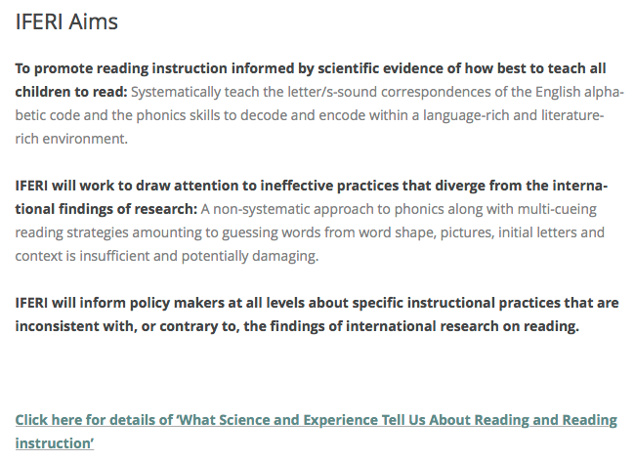
Founded
2015
International
policy shapers
academics
practitioners
parents – all
working together.
Evidence of research, practice and educational and political developments internationally.

Slide 19
“To this day, … the way in which learners are taught (or not taught) remains a matter of CHANCE.”
In 2017, and with the advent of the internet, how can this be?

Slide 20
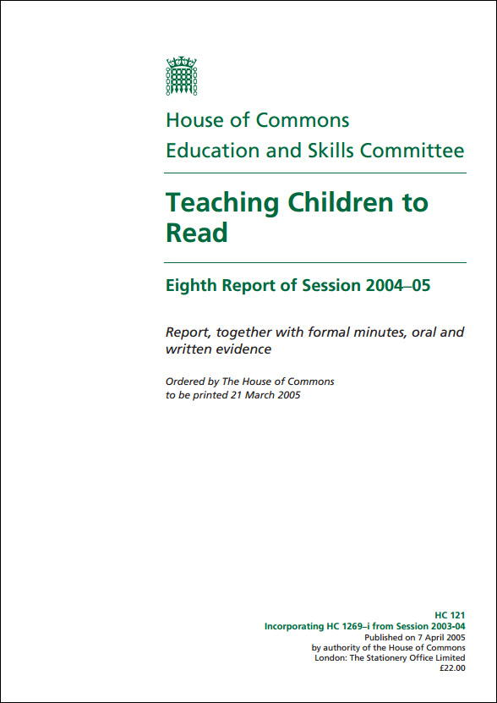
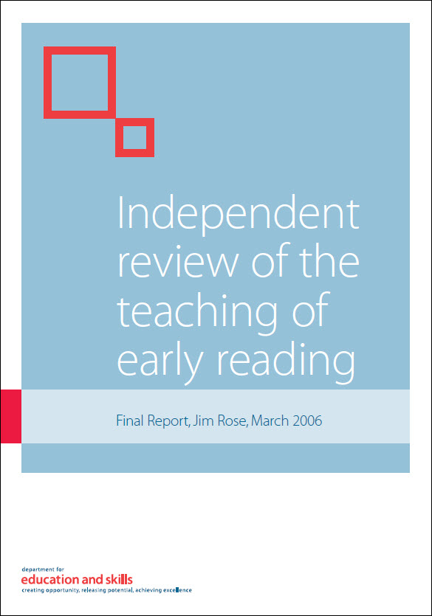
Findings and guidance according to major international inquiries
UK 2005/6
USA 2000
Australia 2005

Slide 21
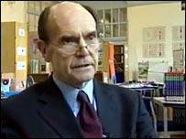
Sir Jim Rose
Founding committee member of IFERI
Far too often, poor literacy is blamed on the context of the learners…

Slide 22
Sir Jim Rose promoted the Simple View of Reading model (Gough & Tunmer 1986)
“It cannot be left to chance, or for children to ferret out, on their own, how the alphabetic code works.” (Sir Jim Rose, Final Report, March 2006)
“We spent a huge amount of time observing practice and noting the spectacular success of systematic synthetic phonics when we found it, sometimes in classes where a significant number of beginners were learning English as an additional language.” (Sir Jim Rose)

Slide 23
The Alphabetic Code and Phonics Skills
Sir Jim Rose addresses the mantra ‘No one size fits all’: Para 34. “…all beginners have to come to terms with the same alphabetic principles if they are to learn to read and write.” Final Report, 2006
Do all learners need to know how the alphabetic code works or not?
And what aspects of phonic work are impossible for them to learn?
Do all teachers need to be knowledgeable about the complex English alphabetic code and how to teach and support in the phonics skills of decoding for reading, and encoding for spelling?

Slide 24
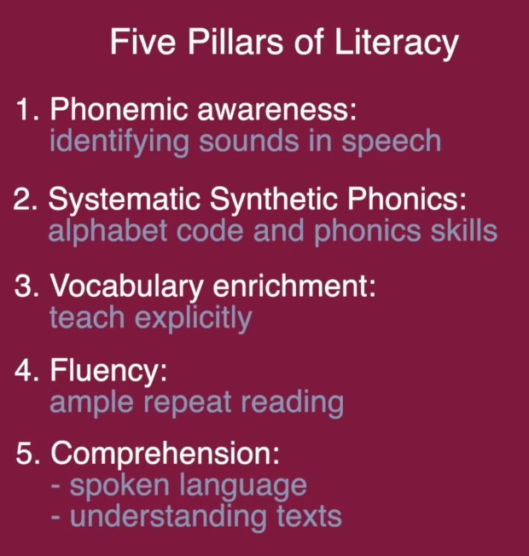
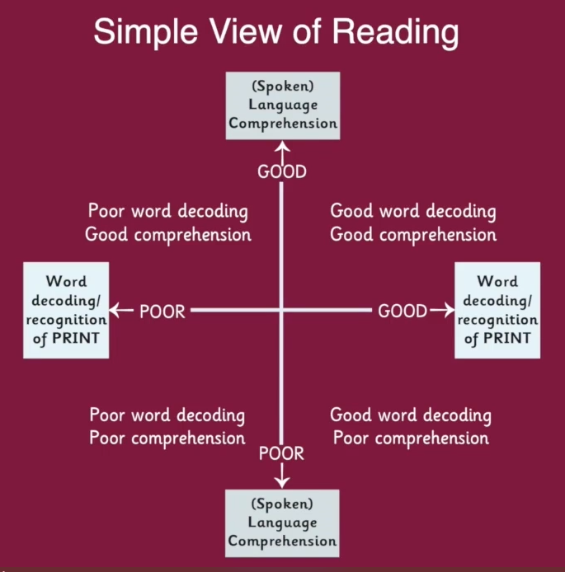
International Research Summaries: We need …
1) What ARE the words?
2) What DO the words mean?
Notes:
International findings from a huge body of research on reading instruction and effective teaching and learning methods, along with many years personal experience, underpin the rationale, the content, the design of the resources and the guidance for the No Nonsense Phonics Skills programme.
In brief: From the research, we know that as teachers we need to provide the ‘Five Pillars of Literacy’. These include training children in phonemic awareness – that is being familiar with the smallest sounds in English speech. We need to teach ‘Systematic Synthetic Phonics’ which is introducing the letter/s-sound correspondences of the alphabetic code incrementally – and how to apply the code with the phonics skills required for reading (decoding), spelling (encoding), and handwriting. Phonemic awareness training is included within the phonics provision.
As teachers, we need to introduce and teach new vocabulary explicitly and build-up children’s confidence and fluency by providing ample repeat-reading opportunities. We always need to focus on language comprehension which is about understanding both spoken language and developing children’s reading comprehension through work with texts.
The Simple View of Reading (first introduced by researchers Gough and Tunmer in 1986) is a model to highlight that there are two main processes for being a reader in the full sense. These include the technical ability to be able to read known and new words efficiently – that is, ‘What ARE the words?’ – and the language comprehension to understand the meaning of the words that have been read or decoded – that is, ‘What do the words MEAN?’. By including a scale from poor to good on the Simple View of Reading diagram, teachers can identify the broad reading profiles of their pupils and plan their teaching accordingly.

Slide 25
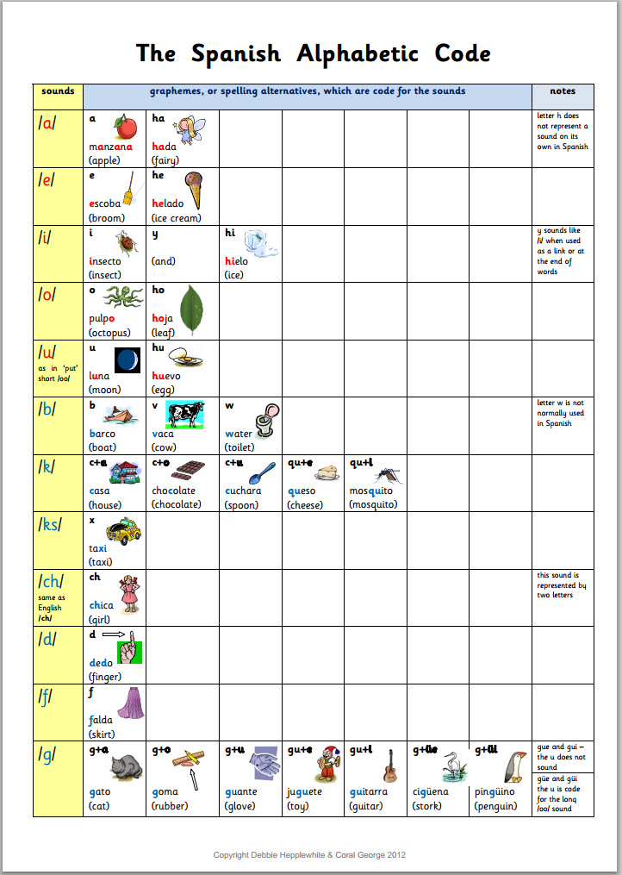
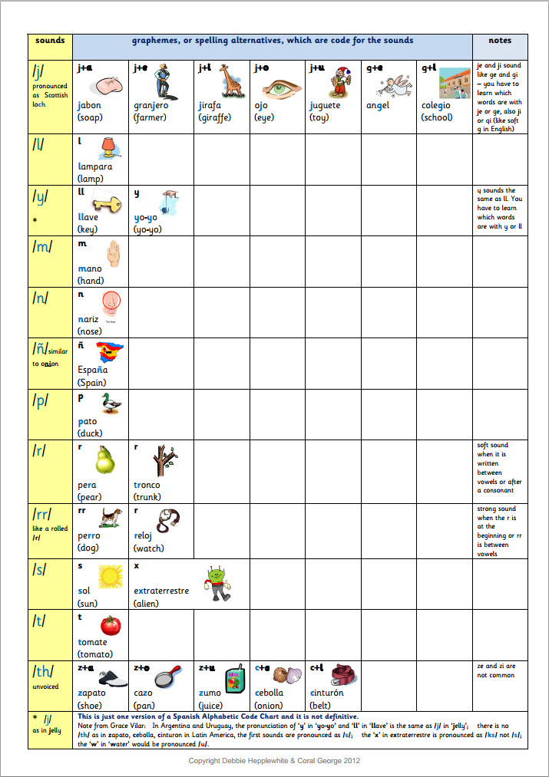
Alphabetic Codes
English:
Opaque code
44 smallest speech sounds (phonemes)
47+ units of sound /k+s/ /kw/ /y+oo/ /ul/
170+ spelling alternatives (graphemes)
(double that for rare & unique spellings)
Spanish:
Transparent code
24 phonemes
40 spelling alternatives
Fewer spelling alternatives in Spanish than sounds in English.
English has the most complex alphabetic code in the world.
Shouldn’t everyone be knowledgeable about this code?

Slide 26
England: official DfE guidance
‘... children should not be expected to use strategies such as whole-word recognition and/or cues from context, grammar, or pictures.’
‘... phonic work is seen not as one of a range of optional methods or strategies for teaching reading but as a body of knowledge and skills about how the alphabet works, which all children should be taught.’
Despite this research-informed official guidance, many schools continue to provide home reading books for children that they cannot read independently without resorting to word-guessing.
But publishers continue to produce books for beginners that are Book Banded and not designed to be ‘decodable’ for beginners…

Slide 27
Schools are full of children’s reading books for beginners that cannot be read without resorting to word-guessing to lift the words off the page.
Some teachers continue to teach children to guess the printed words from various cues, or clues.
Some organisations continue to promote multi-cueing word-guessing strategies for lifting the words off the page.

Slide 28
The downside of Book Bands …
See blog at www.rrf.org.uk for full printable statement.

Slide 29
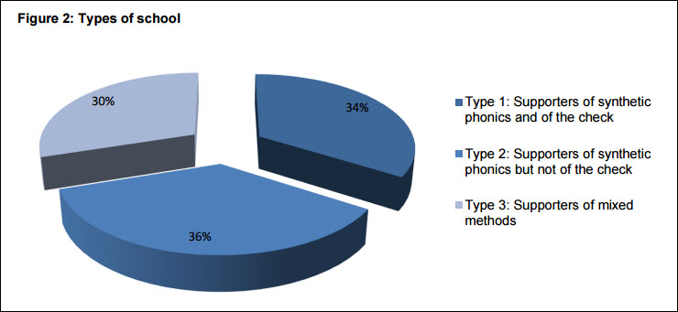
NFER Surveys 2013-5: The realities of ‘professional understanding’ in England
NFER report, 2014: page 60
This shows that how children are taught is still ‘chance’.
All teachers would welcome the Y1 Phonics Screening Check if they understood its importance well enough. This is about CPD.
The DfE commissioned the NFER to conduct a three-year survey of teachers’ phonics provision and their opinions about the Y1 Phonics Check.

Slide 30
The realities of ‘professional understanding’ in England
Two articles I’ve written for SEN Magazine:
Where next for phonics? “So what looks clear from the NFER report is that the picture of phonics provision in schools in England is, in fact, far from clear.”
https://senmagazine.co.uk/articles/articles/senarticles/where-next-for-phonics
Phonics: politics and practice “The following are selected bullet points from Ready to read – how a sample of primary schools in Stoke-on-Trent teach pupils to read (Ofsted, June 2014):
“Not all the schools taught early reading using phonic decoding as ‘the route to decode words’, as required by the national curriculum 2014.”
“Almost all the schools visited used a wide range of early reading books to teach young children to read. Many of these books, however, were not ‘closely matched to pupils’ developing phonics knowledge and knowledge of common exception words’. In other words, the books used did not support young children to practise and apply the phonics they were learning.”
https://senmagazine.co.uk/articles/articles/senarticles/phonics-politics-and-practice

Slide 31
How Does Phonics Provision Vary?
Phonics and reading looks very different in different schools and even in different classes in the same school.
So, children’s experiences in school continue to be based on ‘chance’.
See bottom of ‘Free Resources’ page at www.phonicsintervention.org for pdf.

Slide 32
How Does Phonics Provision Vary?
*’Pick and mix’ of commercial phonics
programmes’ resources to equip L & S
*Mini whiteboards main activity (sound-to-print spelling)
*Lack of word-level blending (reading)
*Minimal content & insufficient time allocated to Teaching & Learning Cycle
*Avoidance of paper-based work
*Lack of text-level phonics work
Rigorous practice
*HT and staff fully committed to content-rich SSP programme, its underpinning guidance
& SSP teaching principles
*No multi-cueing word-guessing strategies
*Intervention ‘little and often’
of same phonics programme & practice
*Welcome & value Y1 PSC
*Most likely to get top results
and consistent results
Fully resourced content-rich systematic phonics programmes
Letters and Sounds
*‘Developmental readiness’ mindset
*Pre-judges what children ‘need’
or will ‘enjoy’ or is ‘appropriate’
*Insufficient challenge in content
*Lack of progression over time
*‘Fun’ activities main focus (extraneous)
*Underestimates children’s potential
*Avoidance of paper-based work
*Lack of text level phonics work
*Half-hearted commitment of at least ‘some’ staff including in some cases, headteacher
*Lack of consistency of programme-use or insufficient time allocated to phonics
*Adapts ‘guidance’ but not necessarily in an appropriate or rigorous way
*Underestimates programme & children
*Working towards cumulative decodable home reading books but not well-equipped
Weak practice

Slide 33
UK: Science and Technology Committee 2009 inquiry - Early Literacy Interventions
Investigated: ‘Every Child a Reader’ (2006) = Reading Recovery
‘The Government’s policy that literacy interventions should take place early on in formal education is in line with the evidence.’
‘The Government’s position that early literacy interventions are an investment that saves money in the long run is evidence-based.’
‘...We conclude that, whilst there is evidence to support early intervention, the Government should not have reached the point of a national roll-out of Reading Recovery without making cost-benefit comparisons with other interventions.’

Slide 34
UK: Science and Technology Committee 2009 inquiry - Early Literacy Interventions
‘Teaching children to read is one of the most important things the State does. The Government has accepted Sir Jim Rose’s recommendation that systematic phonics should be at the heart of the Government’s strategy for teaching children to read. This is in conflict with the continuing practice of word memorisation and other teaching practices of the ‘whole language theory of reading’ used particularly in Wave 3 Reading Recovery. The Government should vigorously review these practices with the objective of ensuring that Reading Recovery complies with its policy.’
What happened to Reading Recovery after this inquiry? In some schools, the weakest learners continue to be sent to Reading Recovery with its multi-cueing reading strategies.

Slide 35
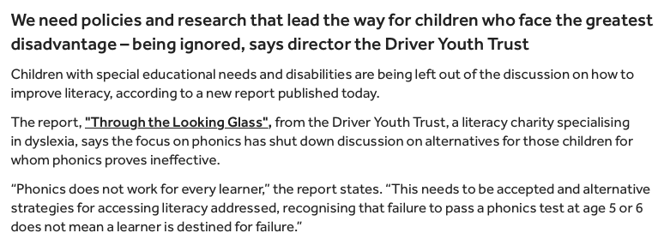
Times Educational Supplement and Driver Youth Trust
‘...a literacy charity specialising in dyslexia, says the focus on phonics has shut down discussion on alternatives for those children for whom phonics proves ineffective. “Phonics does not work for every learner,” the report states.’
This is a shocking statement, mystifying for an organisation focused on ‘dyslexia’ and totally misguided. It gives teachers, parents and others the wrong message about the importance of phonics for all – common sense and verified by science.

Slide 36
Driver Youth Trust guidance on reading
These are flawed multi-cueing word-guessing strategies.
Note there is nothing at all about the alphabetic code and all-through-the-word sounding out and blending:
Look at the picture for clues.
Look at the word: are there any bits of the word they know?
Reread the sentence and think of a word that makes sense.
Check what letter the word begins with and what the rest of the word looks like.

Slide 37
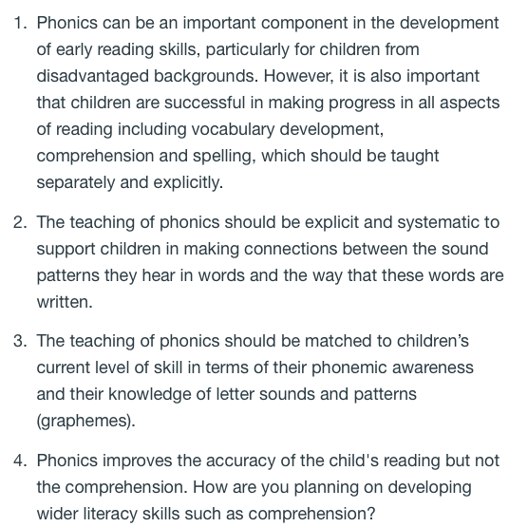
EEF on phonics…
1. It’s not that ‘Phonics can be an important component’, phonics IS an essential component in early reading and writing/spelling skills – not merely ‘can be’.
4. Phonics underpins the child’s reading comprehension.

Slide 38
EEF ‘Phonics’ webpage…
“For older readers who are still struggling to develop reading skills, phonics approaches may be less successful than other approaches such as Reading comprehension strategies and Meta-cognition and self-regulation. The difference may indicate that children aged 10 or above who have not succeeded using phonics approaches previously require a different approach, or that these students have other difficulties related to vocabulary and comprehension which phonics does not target.”
This statement is wrong. The age of the learner does not matter. If the learner’s weakness is in alphabetic code knowledge and/or the blending (synthesising) skill, then that is the knowledge and/or skills gap that must be addressed.

Slide 39
‘Phonicsphobics’ and detractors in the media
The battle for evidence-informed reading instruction continues despite years of research findings and year-on-year improvements in phonics teaching effectiveness in England.
Detractors include children’s authors, teachers’ union leaders, literacy organisations such as the United Kingdom Literacy Association, academics, parents, journalists and various people in the teaching profession.
The good news is that Australia may be about to introduce a Year One Phonics Screening Check as education minister, Simon Birmingham, calls for a review of foundational literacy. We need a phonics check worldwide to inform teachers everywhere.
See www.rrf.org.uk and www.iferi.org to follow developments. www.dyslexics.org.uk www.phonicsintervention.org www.phonicsinternational.com

Slide 40
Accountability
Same conclusion as my talk for the RRF conference in 2015 …
Teachers are not to blame.
Teachers have had nothing but mixed messages from people in various positions of authority about what to teach, that they should not teach, how to teach, how not to teach, how long to teach - for decades, if not centuries.
But it is time for far greater clarity about the issues and the research findings regarding multi-cueing reading strategies – we need deeper professional development.
People in authority remain culpable for lack of clarity and continued mixed messages to teachers.
We can teach virtually all children to read, spell and write. Teachers just need to know, really know, what the research on reading shows us and how most effectively to teach and how most effectively all children can learn.

